Slide 1
Stu
Piratez:
Hunter Davis
Tanner Mindrum
Oscar Gepiga
Tymee Kong
Shihong Sun

Slide 2
Explaining our App
Inspiration
Easy connectivity and open communication between friends
Allow users to view their friend’s statuses and what they’re up to in order to easily coordinate plans with members in a group
Local Hotspot pings to bring a sense of locality and events within campuses and communities
Description
Will allow users to easily view their friends list, groups, and favorites and all of their posted statuses
Users can use pings to notify nearby friends (private) or users (public) of current events:
Ex. Drake is currently at the Pyramid, Dollar Fries at the Nugget

Slide 3
Potential Technologies
Android/iOS application
Google Maps API
Location Services & Map View
Machine Learning implementation
Sentiment Analysis
Database in MySQL
Secure account data storage

Slide 4
Sprint Planning Strategy
Split User Stories into Tasks
Assign Tasks a value based on time needed to complete
E.g. Score of 4 equals 4 hours of work from 1 person
Plan an outline of application technologies and app details to implement
Begin to implement basic Minimum Viable Product (app interface, database connection & design)

Slide 5
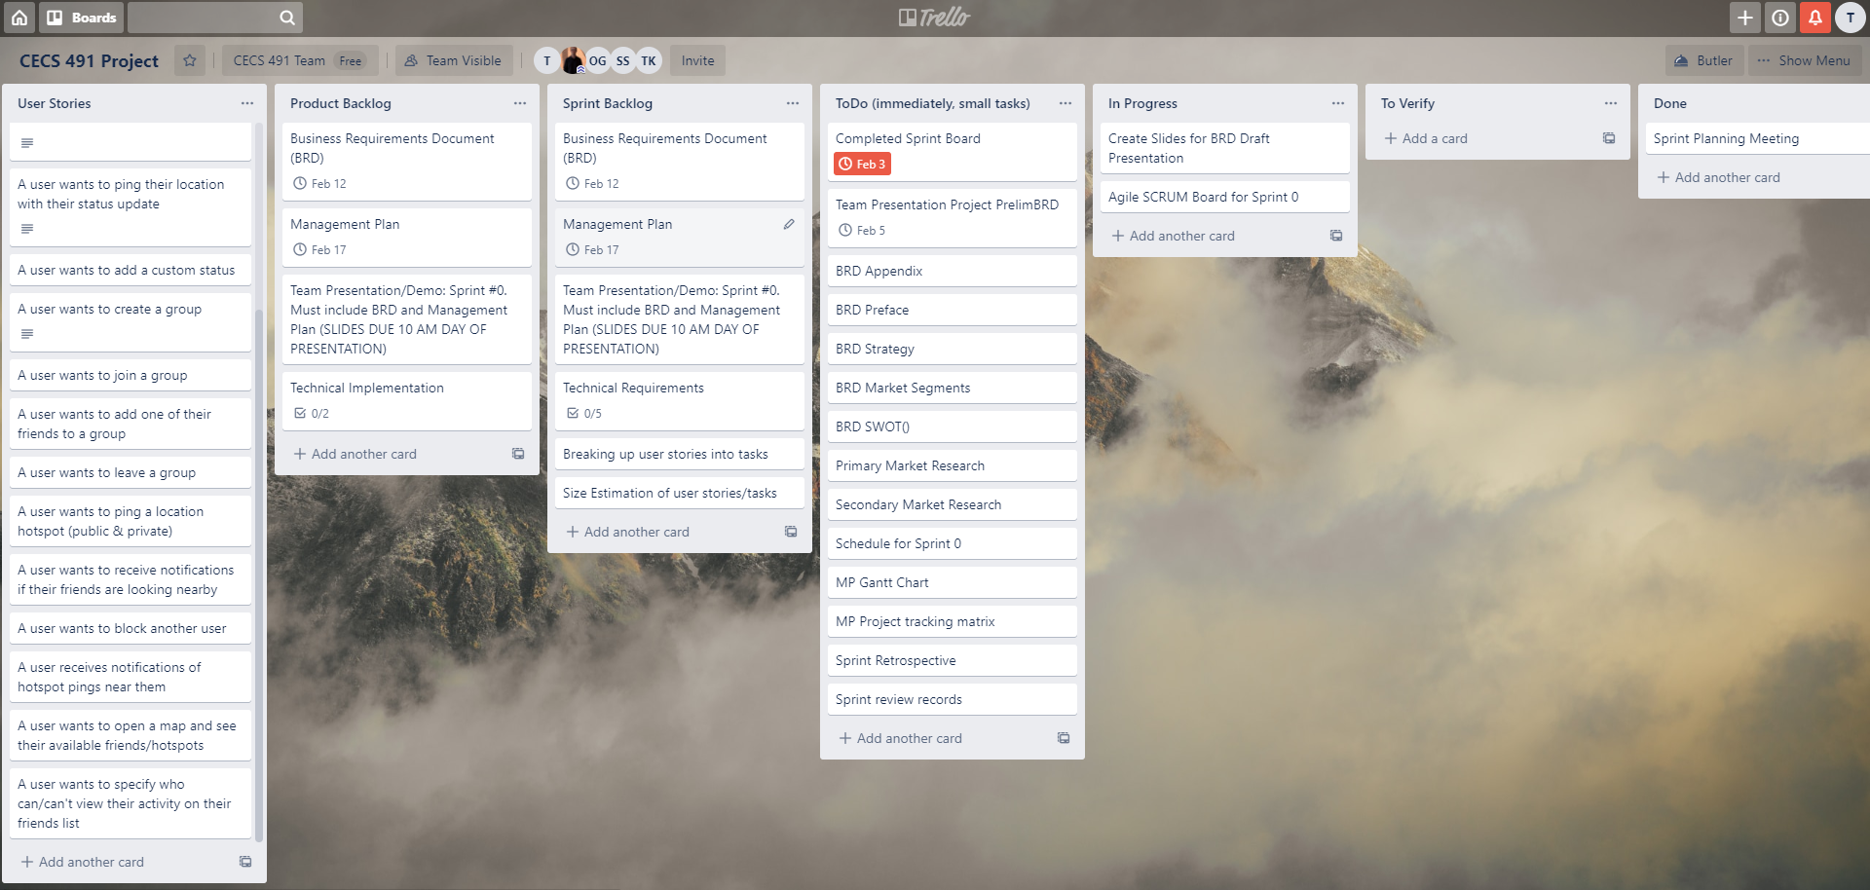
Sprint Board (Trello)

Slide 6
Market Segment Profile
College / High school Students
Age 16 - 25
Over 20 million high school student in American from 2019
15 million public , 5 million private
19.9 million college students in America from fall 2019
12.1 million full time, 7.8 million part time
Over 40 million market size for this project

Slide 7
Criteria for Market Segments
Identifiable
Trage for the market is clear
Substantial
The project can help the student join the camps fast
Accessible
Every student has smart device
Stable
This market will be grow every year
Differentiable
Personal content can be personalized
Actionable
Students are more receptive to new things

Slide 8

Justina, the Struggling Student
Personal Background:
20 years old, lives w/ parents
Lifestyle
Full time student, part time job.
Challenges:
Juggles between personal and professional lives.

Slide 9
Example User Story
“A user wants to create an account in the database”
“A user wants to add a friend”
“A user wants to set their status”
etc.

Slide 10
Primary Market Research
Ourselves (for now)
Plan on interviewing/surveying potential market segments
College/High School Students
Social Groups
Closely located communities
Co-workers within a company
Methodologies:
Surveys via Reddit/Google
In-person questionnaire

Slide 11
Secondary Market Research URLs
Introduction to location-based social media
Location-Based Service for a Social Network with Time and Space Information
A Concept of Location-Based Social Network Marketing
The Problem with Location Based Social Networks
Market Info & Size
Location-Based Marketing: Where is it Today and Where is it Heading?
Location-Based Services Market Statistics

Slide 12
Secondary Market Research Location-Based Platform
Social networks that implement GPS features to allow users to broadcast their location or advertisers to market using specific locations
User side: Ability to view other user’s location and interact with their map and anything on it

Slide 13
Secondary Market Research - Users
The use of our location-based social media platform is primarily driven by users alone
Users: Any persona that has a desire to interact with people and their surroundings in a more dynamic way

Slide 14
Secondary Market Research Segments
Based on social media types, the market is segmented into
Social Networks
Media Sharing Networks
Discussion Forums
Bookmarking & Content Curation
Consumer Review Networks
Blogging & Publishing Networks
Social Shopping Networks
Interest-Based Networks

Slide 15
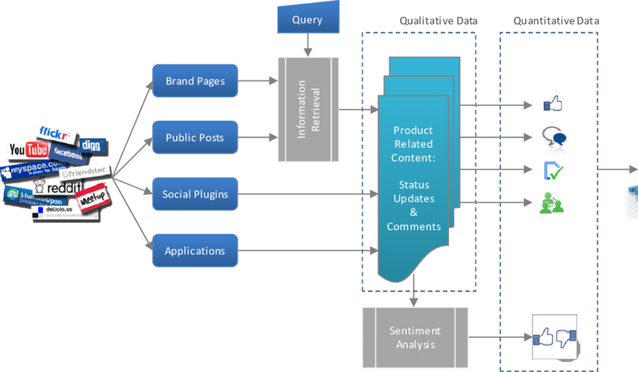

Slide 16
SWOT (Strengths)
Will help students bridge the gap between their work life and their personal life
Help students manage their time between leisure and productivity
It can help students meet new people

Slide 17
SWOT (Weaknesses)
This app targets a very specific audience
Privacy
The app would require location data of people using it
This app is similar to other types of social media such as Facebook

Slide 18
SWOT(Opportunities)
Could be expanded to more functionality
Adding more features such as group chats
Pinging locations on the map

Slide 19
SWOT(Threats)
Social media websites such as Facebook are similar to our app
If data is not secured properly, people could steal data
Similar to find my friends on Snapchat

